Slide 1
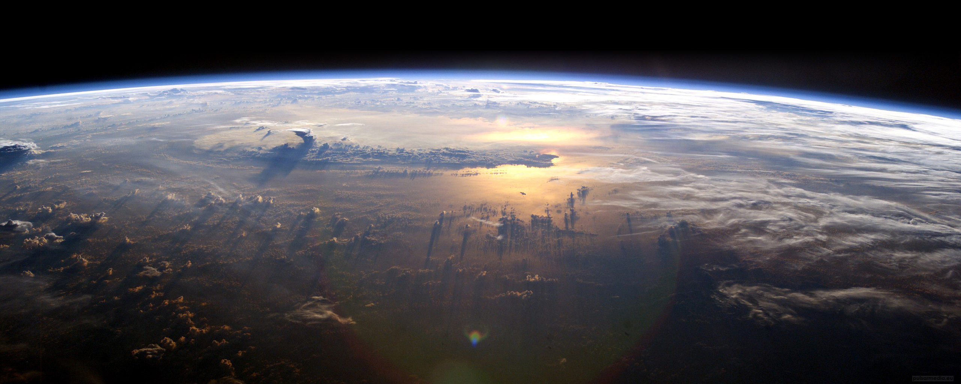
Using atmospheric modeling to assess human health impacts
J. Jason West
Environmental Sciences & Engineering
University of North Carolina, Chapel Hill
west.web.unc.edu
@ProfJasonWest

Slide 2
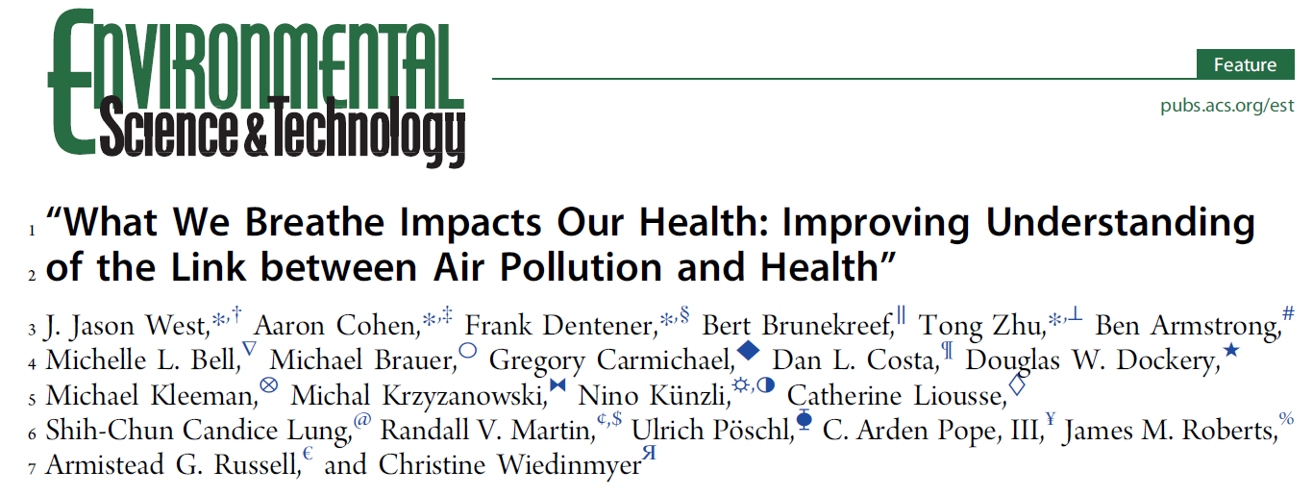
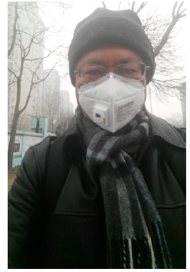
Air pollution is underappreciated for global health.
Air pollution and its health impacts are changing globally, and will change in ways interrelated with climate change.
Air pollution science offers new possibilities: new measurement methods measuring more chemical components, cheap sensors that can be widely deployed, satellites, and models.
There is a need for the communities of air pollution science and air pollution health effects science to work together better.

Slide 3
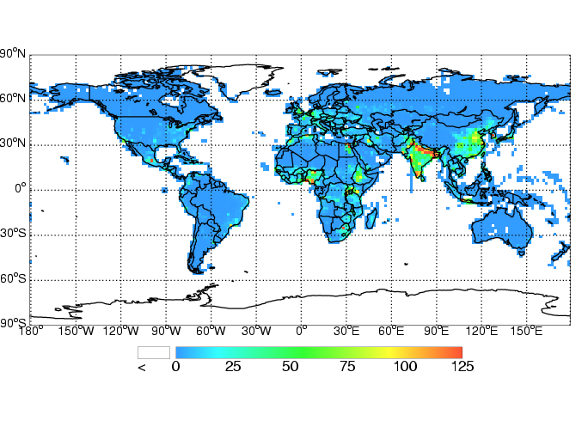
-20% Global Anthropogenic Methane Emissions:
30,200 avoided premature deaths in 2030 due to reduced ozone
West et al., PNAS, 2006

Slide 4
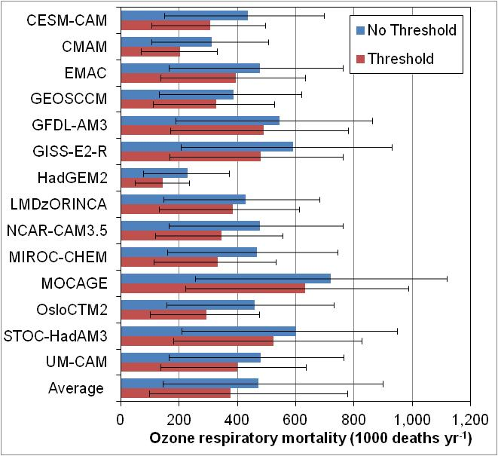
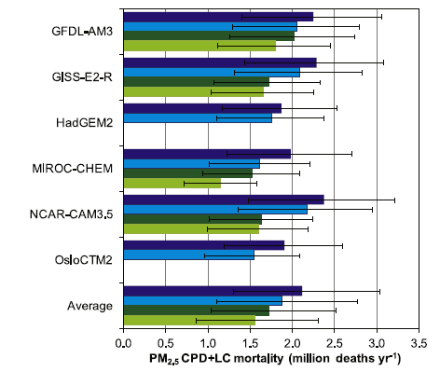
Global mortality burden – ACCMIP ensemble
Ozone-related mortality
PM_{2.5}-related mortality(*)
470,000 (95% CI: 140,000 - 900,000)
2.1 million (95% CI: 1.3 - 3.0 million)
(*) PM_{2.5} calculated as a sum of species (dark blue)
PM_{2.5} as reported by 4 models (dark green)
Light-colored bars - low-concentration threshold (5.8 µg m⁻³)
Silva et al. (ERL, 2013)
Notes:
1 - The average estimate across the 14 models (whose acronyms are labels in Y axis) suggests that 470 000 (four hundred and seventy thousand) premature respiratory deaths occur globally and annually due to anthropogenic increases in ozone, with no low-concentration threshold (blue bars).
Accounting for both the 95% confidence interval (CI) on the CRF, reported by Jerrett et al (2009), and the distribution of results from the 14 models, using Monte Carlo sampling, yields a 95% CI of 140 000 to 900 000.
Global ozone mortality is about 20% lower when a low-concentration threshold is used (red bars), as shown by a sensitivity analysis of the results to a low-concentration threshold of 33.3 ppb for ozone, below which changes in concentration are assumed to have no effect, as these are the lowest measured levels in the ACS studies.
2 - For PM2.5 estimated as a sum of species (solid bars), the 6-model average indicates that 2.1 (1.3 to 3.0) million premature CPD and LC deaths occur globally and annually due to anthropogenic increases, with no low-concentration threshold. Of these deaths, 93% are related to CPD and 7% to LC. Global PM2.5 mortality is 11% lower for the multi-model average when using a low-concentration threshold of 5.8 ug/m3. The formulas for estimating PM2.5 differ between models. As another sensitivity analysis, mortality using the PM2.5 reported by 4 models (hashed bars) was estimated, and it is 19% lower than the 6-model average.

Slide 5
Global burden of disease of air pollution (2017)
Global Deaths per Year
Ambient PM_{2.5} pollution: 2.9 (2.5 – 3.4) million
Ambient ozone pollution: 0.47 (0.18 – 0.77) million
Household air pollution from solid fuels: 1.6 (1.4 – 1.9) million
1 in 19 deaths globally!
1 in 45 deaths globally!
Ambient PM_{2.5} pollution is the 8th leading risk factor for death globally.
Burnett et al. (PNAS, 2018) estimate 8.9 (7.5-10.3) million deaths from PM_{2.5} in 2015.
GBD 2017 Team, Lancet, 2018

Slide 6
Impact of RCP8.5 Climate Change on Global Air Pollution Mortality: ACCMIP Models
Mean | (95% CI)
(deaths yr⁻¹)
2030
3,000 (-30,000, 47,000)
2100
44,000 (-195,000, 237,000)
OZONE
Million deaths yr⁻¹
Mean | (95% CI)
(deaths yr⁻¹)
2030
56,000 (-34,000 , 164,000)
2100
215,000 (-76,000 , 595,000)
PM_{2.5}
Silva et al. Nat Clim Ch, 2017

Slide 7

Health Benefits of Decreases in PM_{2.5} and Ozone in the United States, 1990-2015
Omar Nawaz, Yuqiang Zhang, Daniel Q. Tong, Aaron van Donkelaar, Randall Martin, J. Jason West
* Air pollutant datasets:
- A 21-year CMAQ simulation (1990-2011) EPA
  - The North American Chemical Reanalysis (2009-2015) NACR
  - N. America PM_{2.5} satellite-derived data combined with a model and surface observations (1999-2012) SAT
* We use annual county-level population and baseline cause-specific mortality rates from the CDC to assess air pollution mortality in each year.

Slide 8
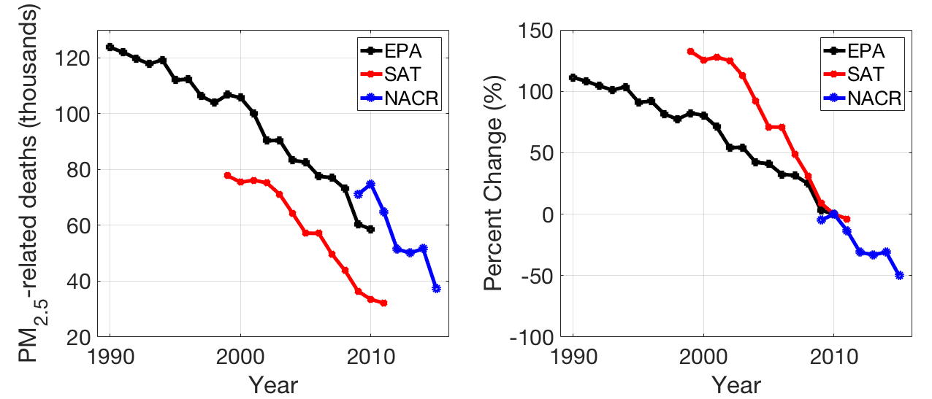
US PM_{2.5}-related deaths
Zhang, ACP 2018; Nawaz, in prep.

Slide 9
PM_{2.5} Mortality Burden (EPA)
PM_{2.5} mortality decreased by 53% from 123,700 (70,800-178,100) deaths in 1990 to 58,600 (24,900-98,500) in 2010.
Without the decrease in PM_{2.5} since 1990, the burden would have only decreased by 24%.
PM_{2.5} reductions since 1990 have decreased deaths in 2010 by about 35,800.
Zhang, ACP 2018

Slide 10
In the US, air pollution kills:
109,000 (2017 from GBD), 1 in 25 US deaths
47,000 (2015 our work), 1 in 58 US deaths
Diabetes: 80,000
Influenza & pneumonia: 52,000
All suicides: 45,000
All transportation accidents: 43,000
Breast cancer: 42,000
All gun shootings: 39,000
Prostate cancer: 30,000
Parkinson’s: 30,000
Leukemia: 23,000
HIV AIDS: 6,000
2016 data from CDC

Slide 11
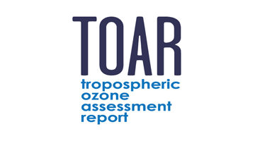

Mapping Global Surface Ozone Concentrations
Goal: Estimate global surface ozone concentrations by statistically fusing global ozone observations and an ensemble of global models.
Stakeholder partners: Global Burden of Disease Assessment – Michael Brauer (UBC), Rick Burnett (Health Canada), Bryan Hubbell (EPA).
Team: Jason West, Marc Serre, Marissa Delang, Jacob Becker, Stephanie Cleland, Elyssa Collins (UNC), Owen Cooper, Kai-Lan Chang (U Colorado & NOAA), Martin Schultz, Sabine Schroder (Julich), CCMI and NASA modelers

Slide 12
Ozone metric: 2008-2014 average of 6-month average 8-hr. daily maximum surface ozone concentration

Slide 13
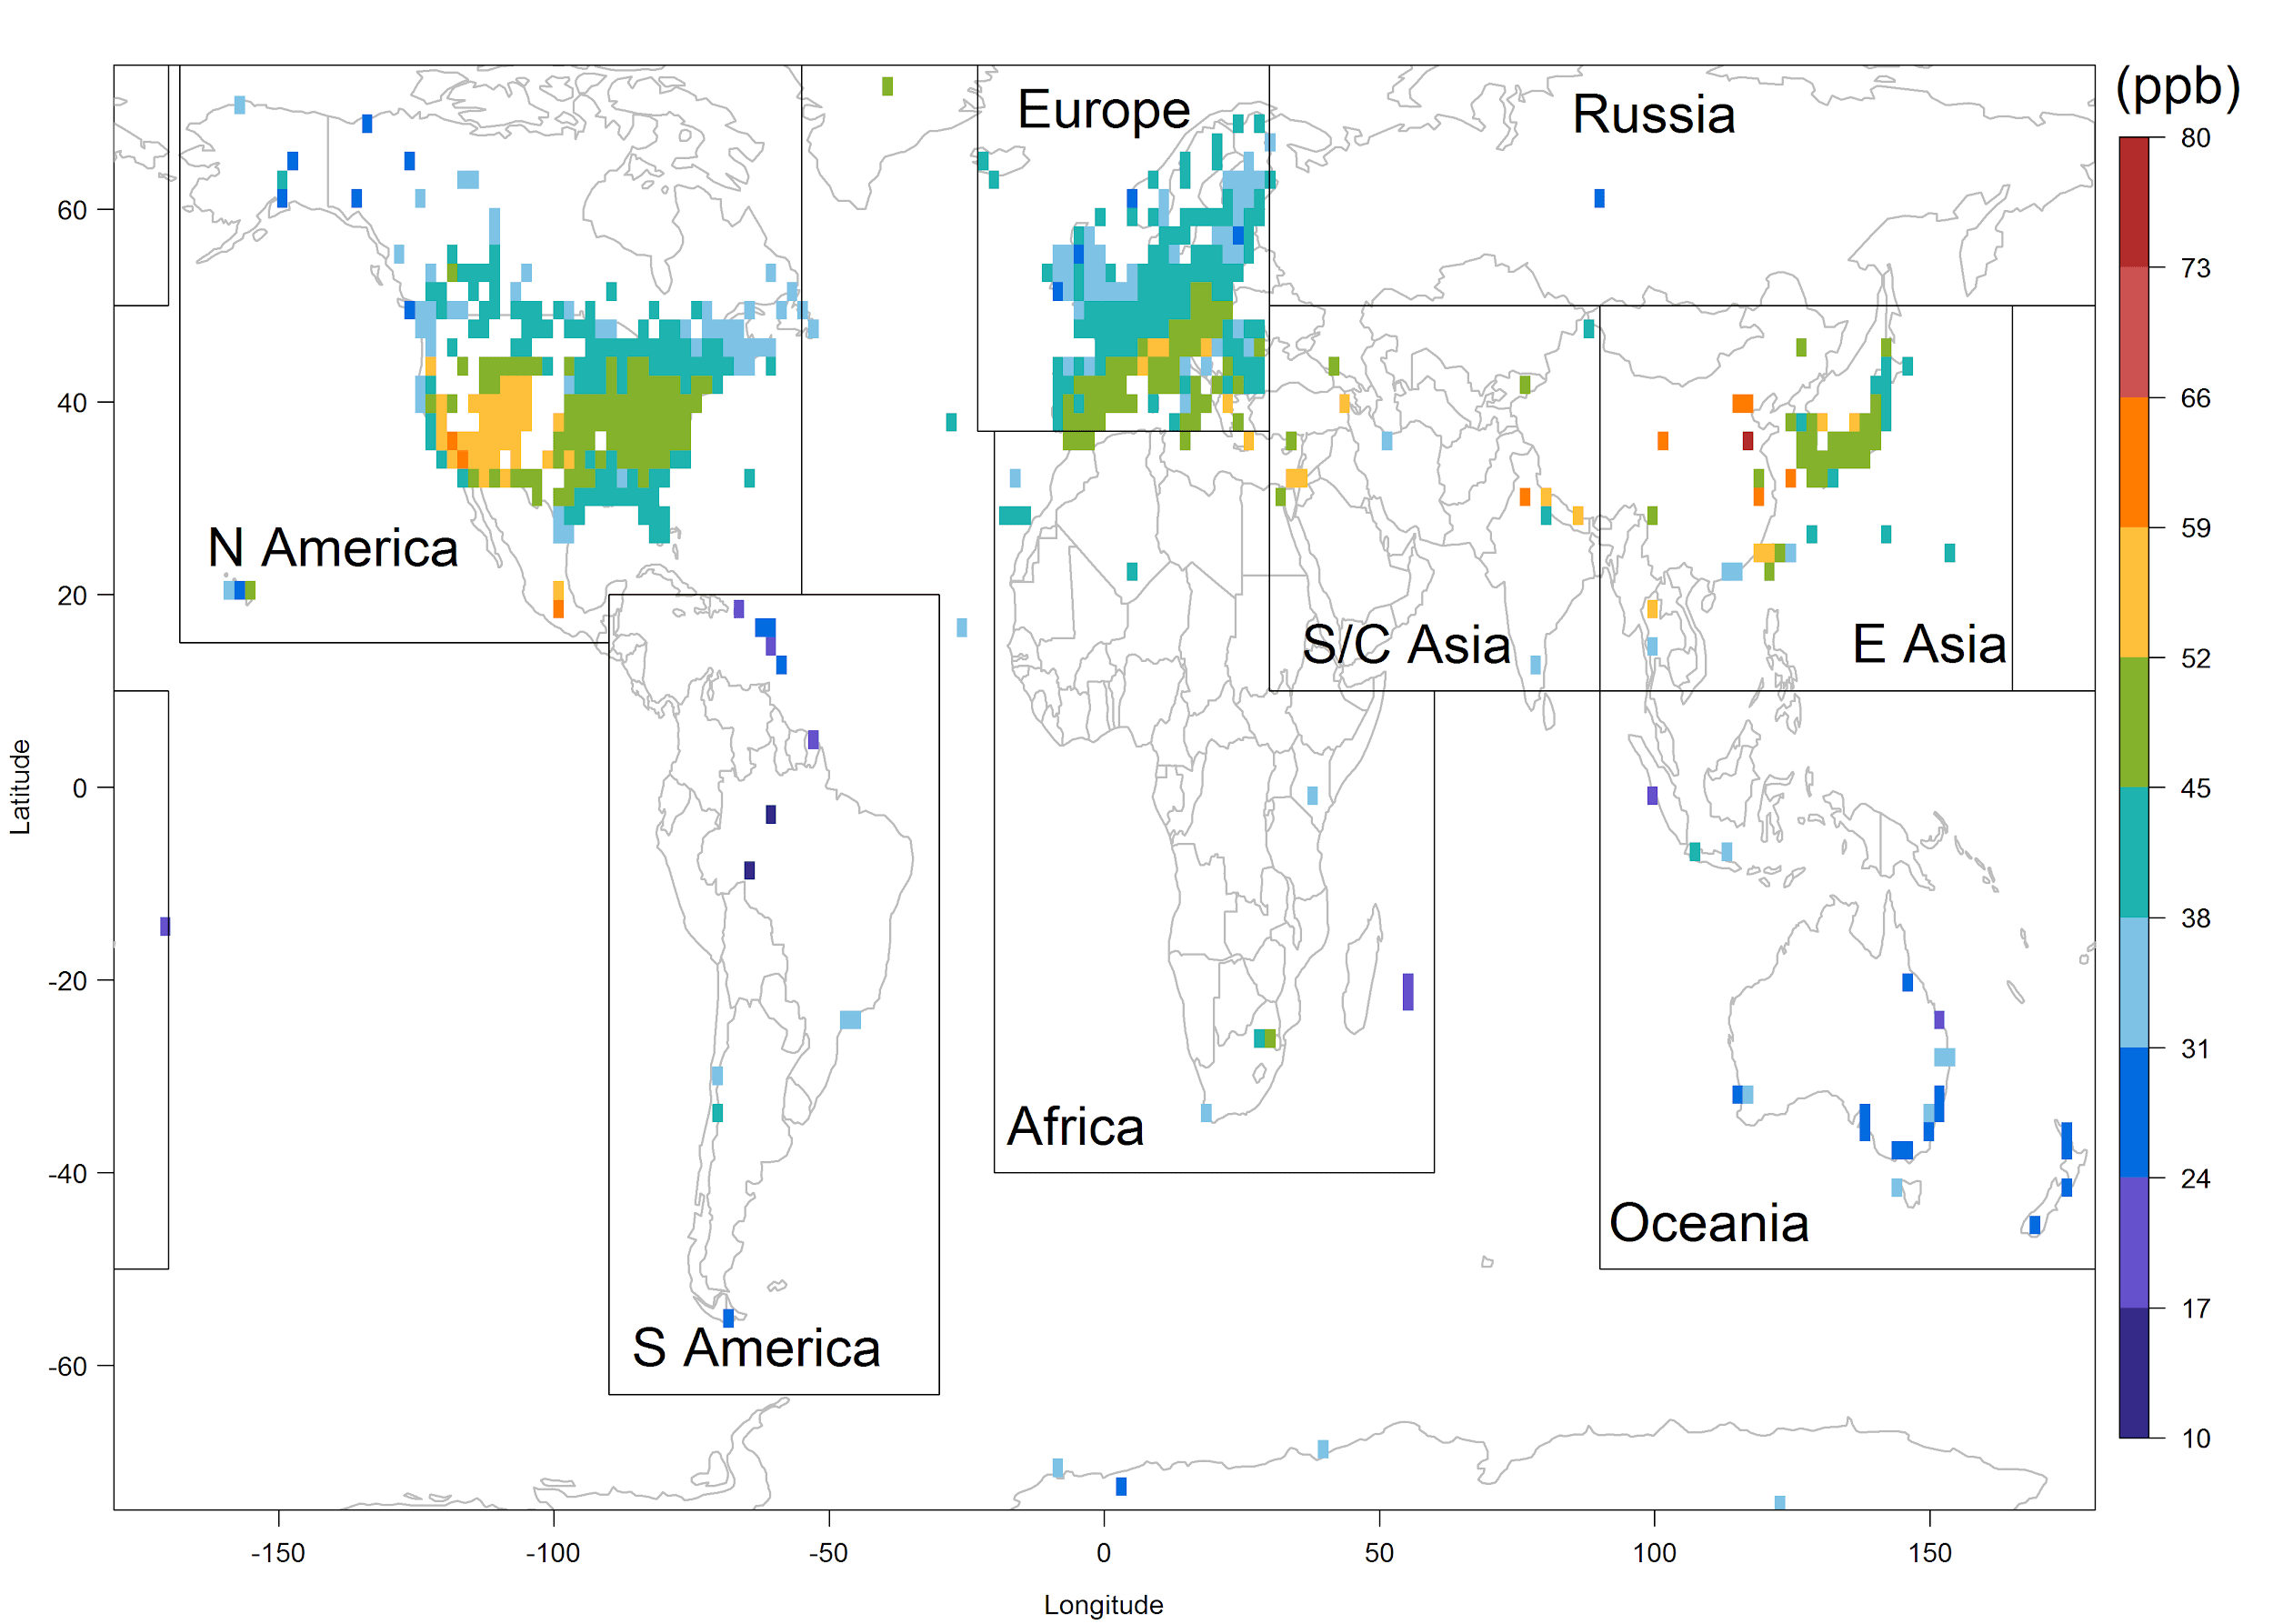
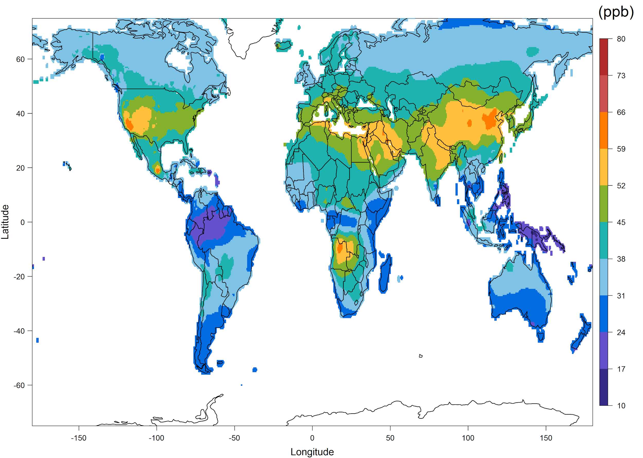
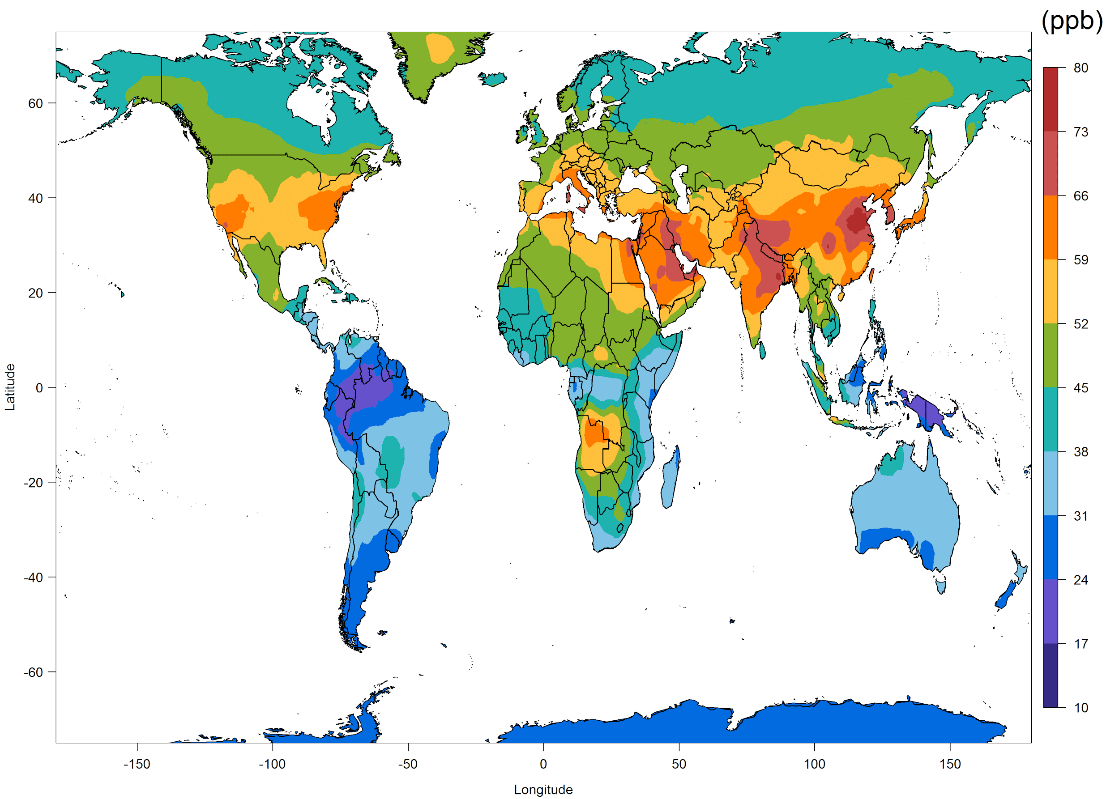
Global Ozone Mapping for GBD 2017
Fused ozone surface concentration used by GBD 2017
Chang et al. (GMD, 2019)

Slide 14
Global Ozone Mapping for GBD 2019
– Produce ozone maps for all years from 1990 to 2017.
– Perform a new data fusion with observations using Bayesian Maximum Entropy method.
– Add new observations from China and elsewhere, updated models.
– Add fine spatial structure using NASA G5NR-chem (0.125°).
New fields have been delivered to GBD at 0.1° resolution for every year from 1990 to 2017.

Slide 15
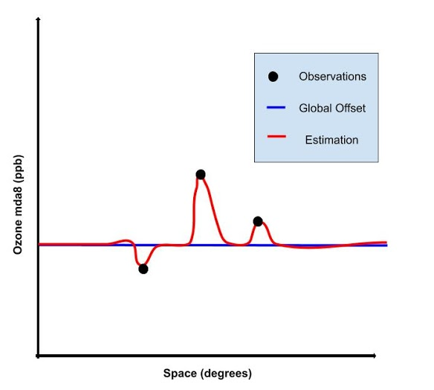
Bayesian Maximum Entropy Methods
M³Fusion
output

Slide 16
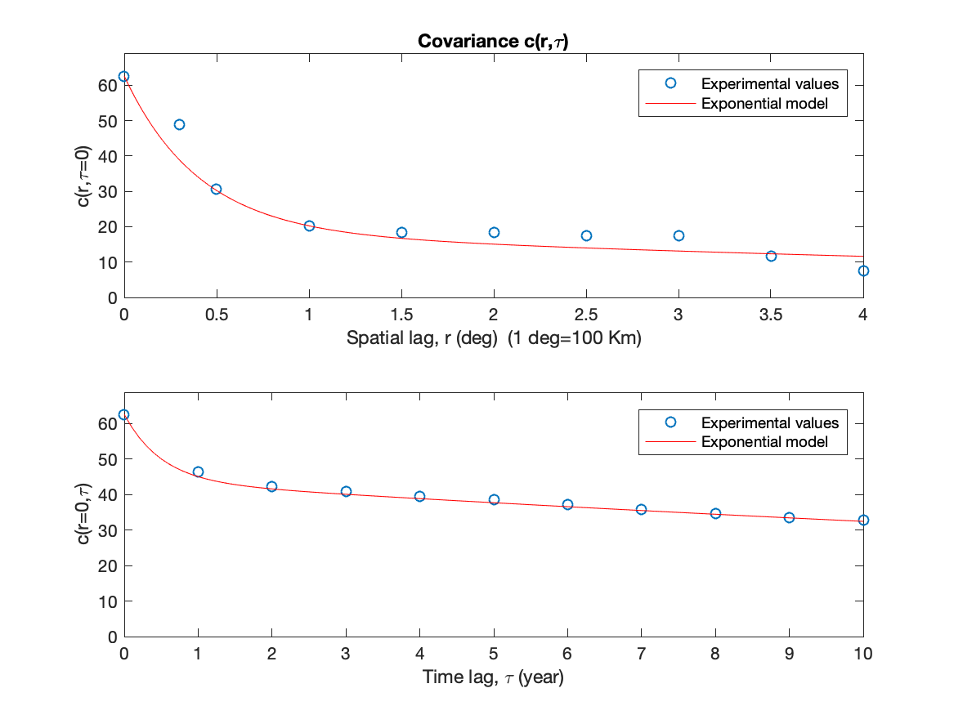
Global Ozone Mapping for GBD 2019

Slide 17
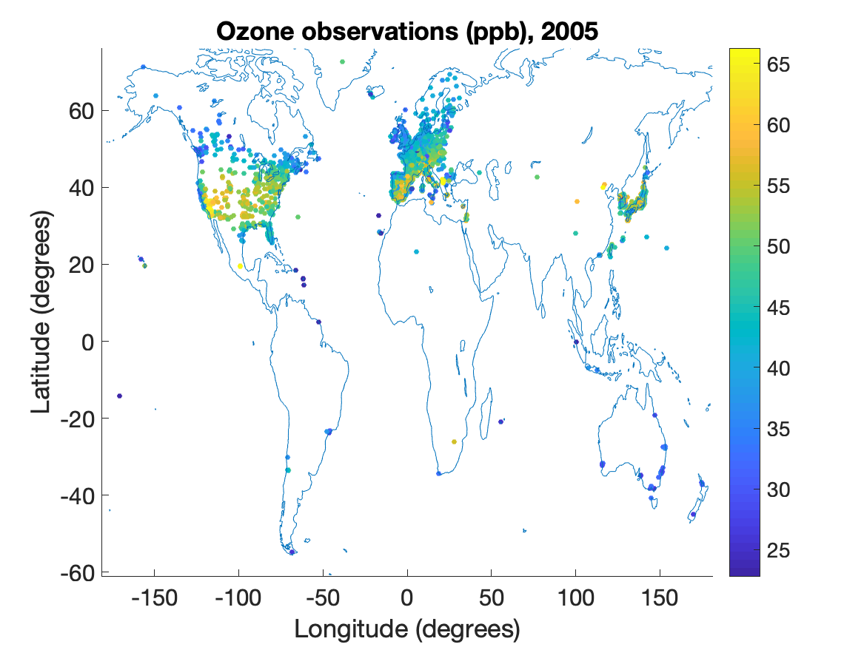
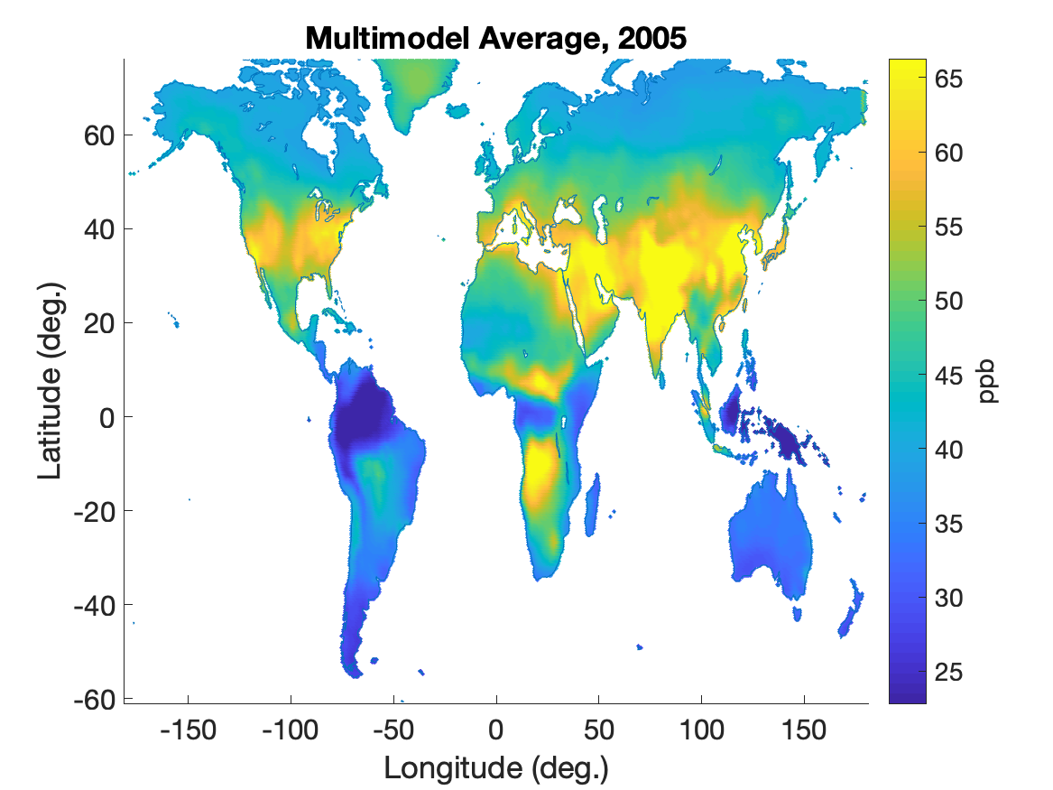
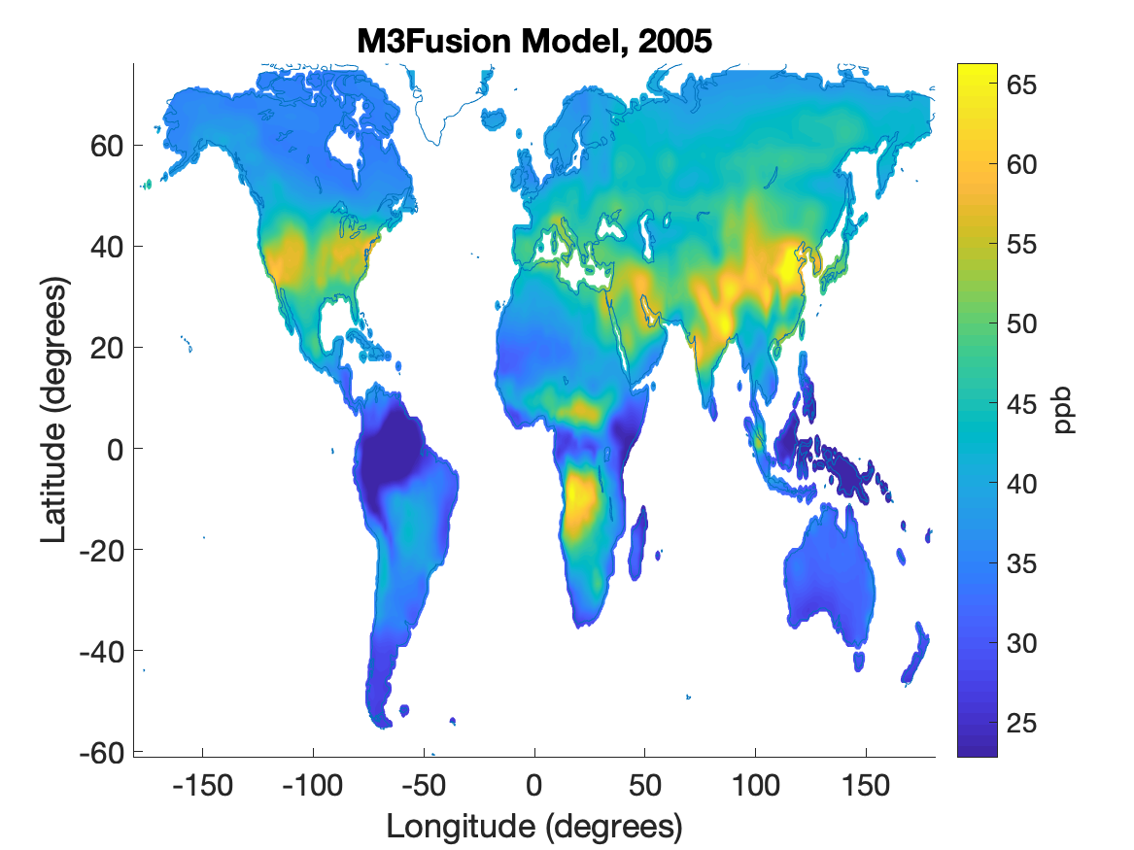
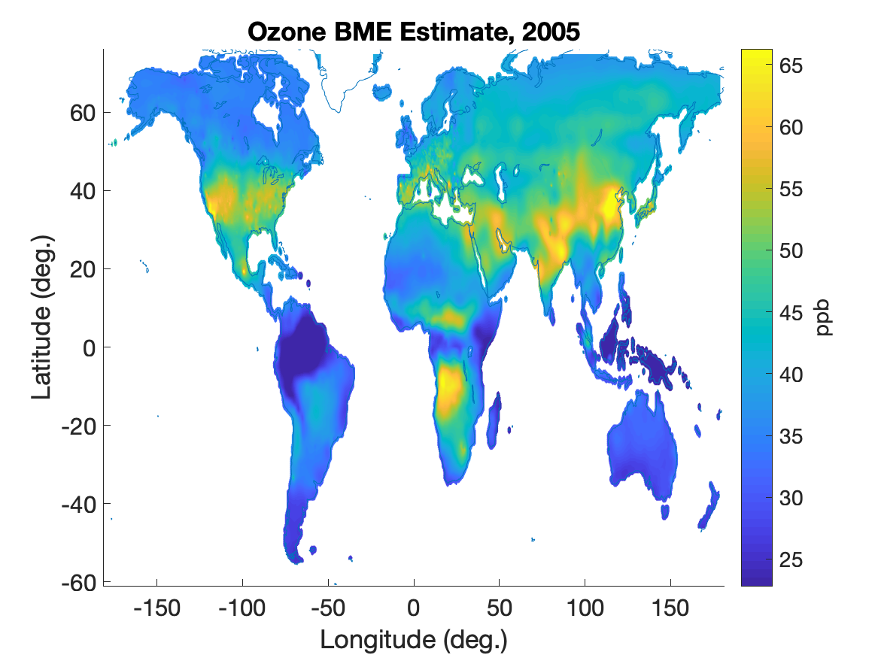
Global Ozone Mapping for GBD 2019
Observations
2005
Multimodel Average
M³Fusion Result
BME Fusion

Slide 18
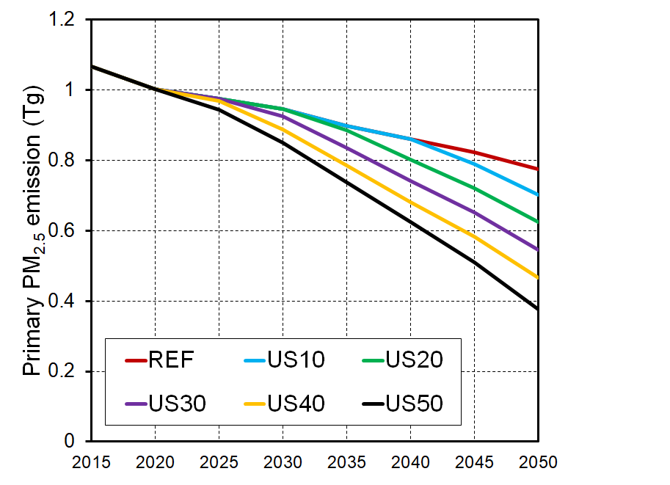
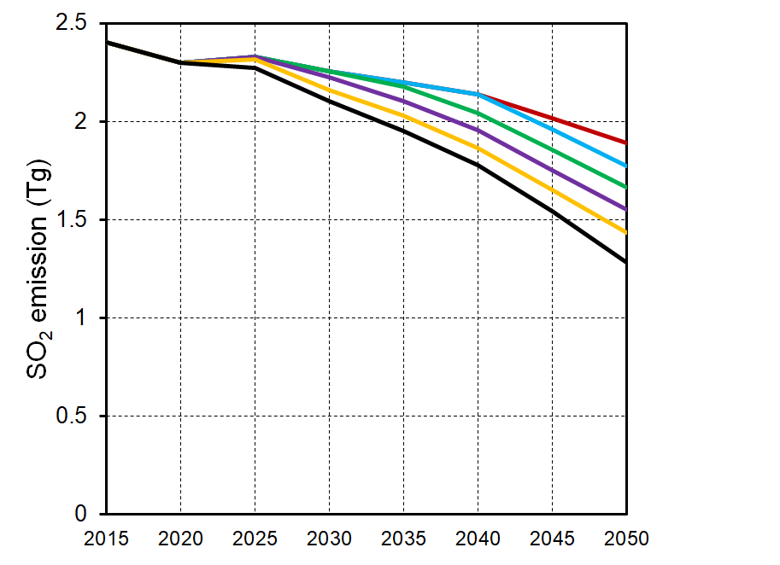
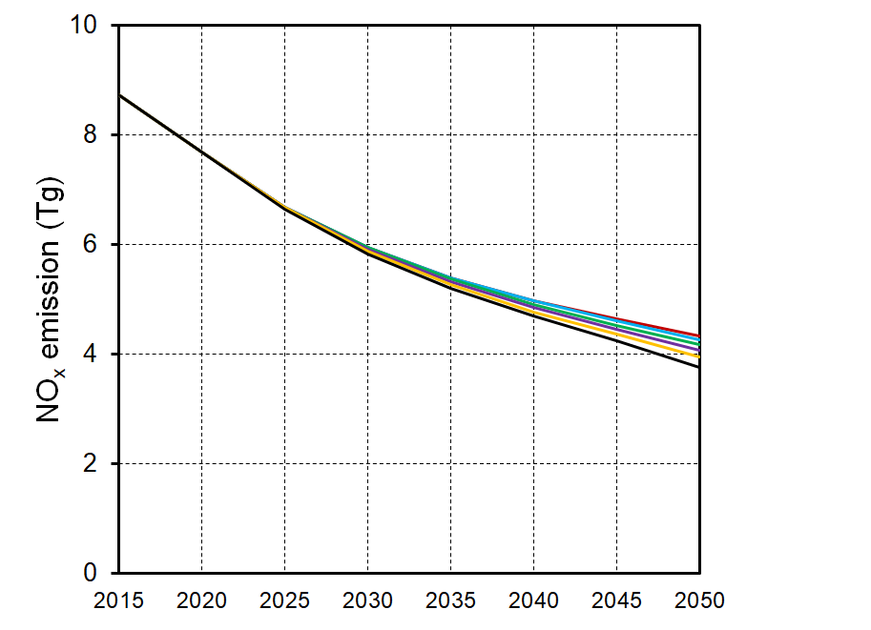
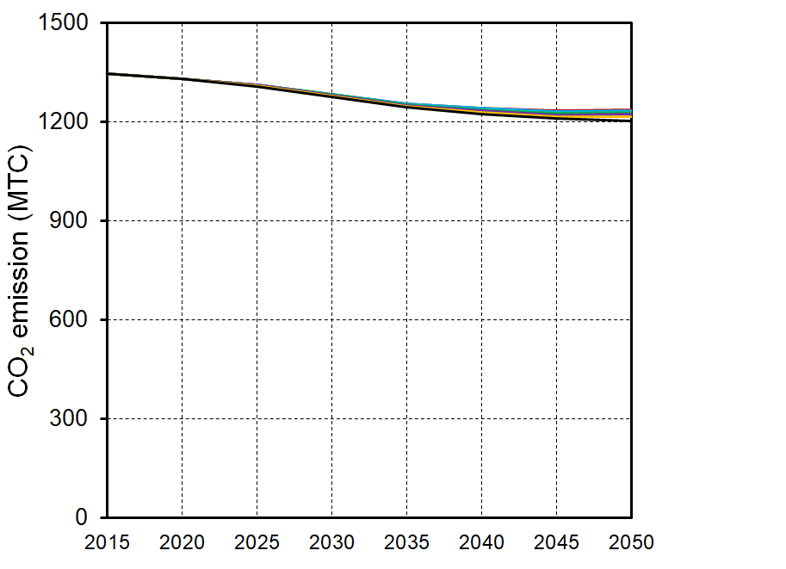
Effects of PM mortality cost targets on emissions
EASIUR reduced form atmospheric model put into GCAM-USA.
The decreased use of industrial coal, building biomass, and industrial liquids
is equivalent to only 2% of the total energy consumption in 2050
contributes 87% of the total PMMC reductions relative to REF.
a
b
PM_{2.5}
SO₂
c
d
NO_{x}
CO₂
Ou et al., in prep.

Slide 19
Co-benefits – Global Premature Mortality
Projection of global population and baseline mortality rates from International Futures.
PM_{2.5} co-benefits
(CPD + lung cancer mortality)
2030: 0.4±0.2 million yr⁻¹
2050: 1.1±0.5
2100: 1.5±0.6
Ozone co-benefits
(respiratory mortality)
2030: 0.09±0.06
2050: 0.2±0.1
2100: 0.7±0.5
West et al. NCC 2013

Slide 20
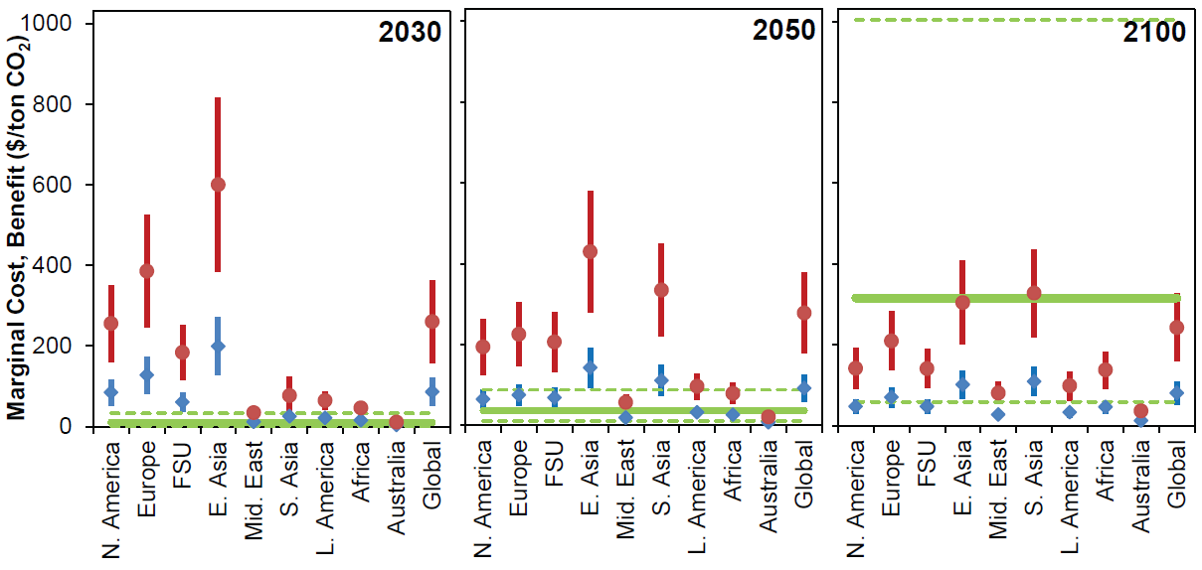
Co-benefits – Valuation of Avoided Mortality
Red: High valuation (2030 global mean $3.6 million)
Blue: Low valuation (2030 global mean $1.2 million)
Green: Median and range of global C price (13 models)
West et al. NCC 2013

Slide 21
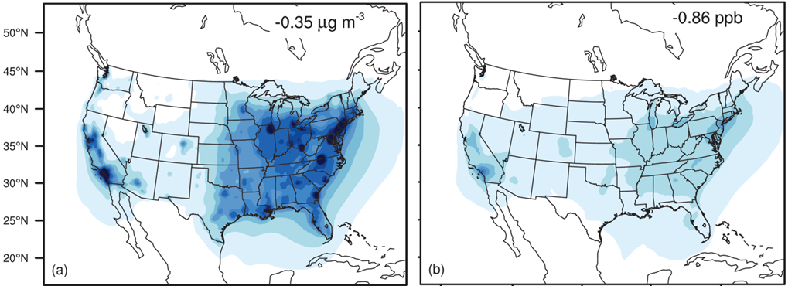
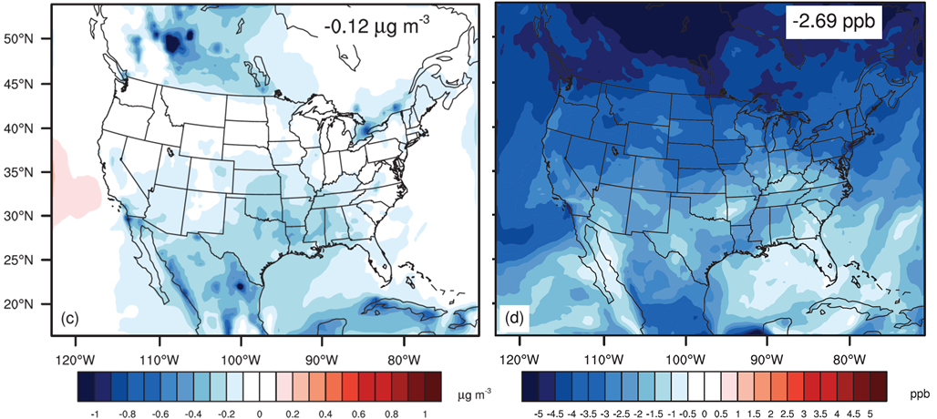
Downscaling Co-benefits to USA (2050)
PM_{2.5}
Ozone
0.35 µg/m³
0.86 ppb
Most PM_{2.5} co-benefits from domestic reductions.
Domestic
Foreign
0.12 µg/m³
2.69 ppb
Most ozone co-benefits from foreign and methane reductions.
Zhang et al. ACP, 2016

Slide 22
Thank you
Contributions from students: Yuqiang Zhang, Raquel A. Silva, Omar Nawaz, Jacob Becker, Marissa Delang, Zachariah Adelman, Meridith Fry, Susan Anenberg, Yang Ou
Collaborators: Steven J. Smith, Jared H. Bowden, Owen Cooper, Kai-Lan Chang, Vaishali Naik, Larry Horowitz, Jean-Francois Lamarque, Drew Shindell, ACCMIP & CCMI modelers, others
Funding Sources:
EPA STAR Grant #834285
NIEHS Grant #1 R21 ES022600-01
NASA Health & Air Quality Applied Sciences Team
EPA Office of Air Quality Planning and Standards
Portugal Foundation for Science and Technology Fellowship
EPA STAR & ORISE Fellowships
UNC Graduate School
US Department of Energy, Office of Science
NOAA GFDL & UNC for computing resources
UNC Climate Health and Air Quality Lab
west.web.unc.edu
Notes:
22

